Slide 1
Sankey Diagram

Slide 2
Pros & Cons
Attention grabbing chart that can be used to check out the importance of entities.
Best used for comparison of before and after.
Position of nodes is very important as overlapping must be reduced
Can make it unreadable with overlapping
Neglecting of minor contributors is allowed, but weightage should also be given.

Slide 3
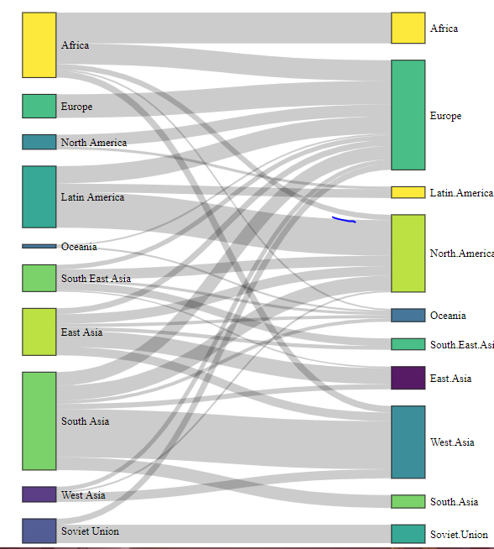
Tourism Example
Width proportion is displayed
Before after scenario
Overlapping of Cross-section
Neglection of minor

Slide 4
